Slide 1
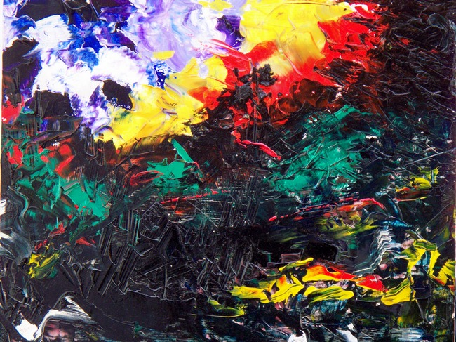
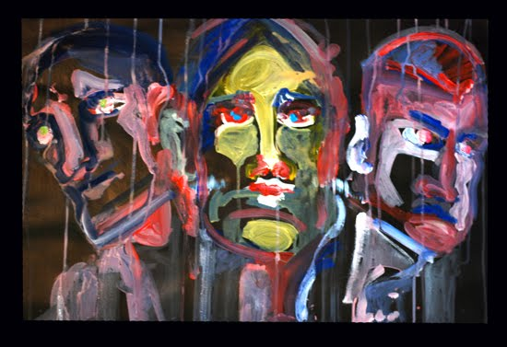
Mental Health
“Same world, different view”

Slide 2
Characteristics of good mental health
Feels good about themselves
Feels comfortable with other people
Able to meet the demands of life
Expresses emotions in healthy ways
Is optimistic (positive)
Uses health skills
  Stress management
  Decision making
  Conflict resolution
Uses “I messages”
Copes/adapts with change
Assertive
Active listener
Can be part of a team/group
Notes:
Share feelings with others

Slide 3
Characteristics of poor mental health
Does NOT share feelings
Emotions control behaviors
Is pessimistic (negative)
Ignores/denies problems
Can not accept change
Lets stress control life
“You” messages (blame and escalate)
Aggressive and passive
Depressed
Runs from conflict
Close minded
Needs to “run” the group

Slide 4

What word to you see first?

Slide 5
What is a mental illness?
Patterns of _______ or behavior, that cause a person significant _______ pain or prevents normal functioning.
Answers: thinking & emotional
(Illness: a disease or period of sickness affecting the body or mind.)

Slide 6
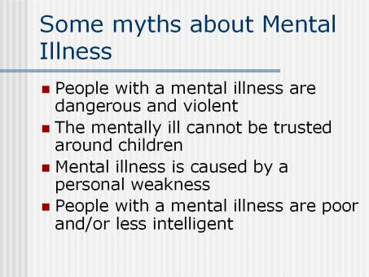

Slide 7
General Causes of Mental Ilnesses
Inherited traits
Negative life experiences (traumatic)
Environmental exposures before birth
  Viruses, toxins, alcohol or drugs
Brain chemistry
  Hormonal imbalances

Slide 8
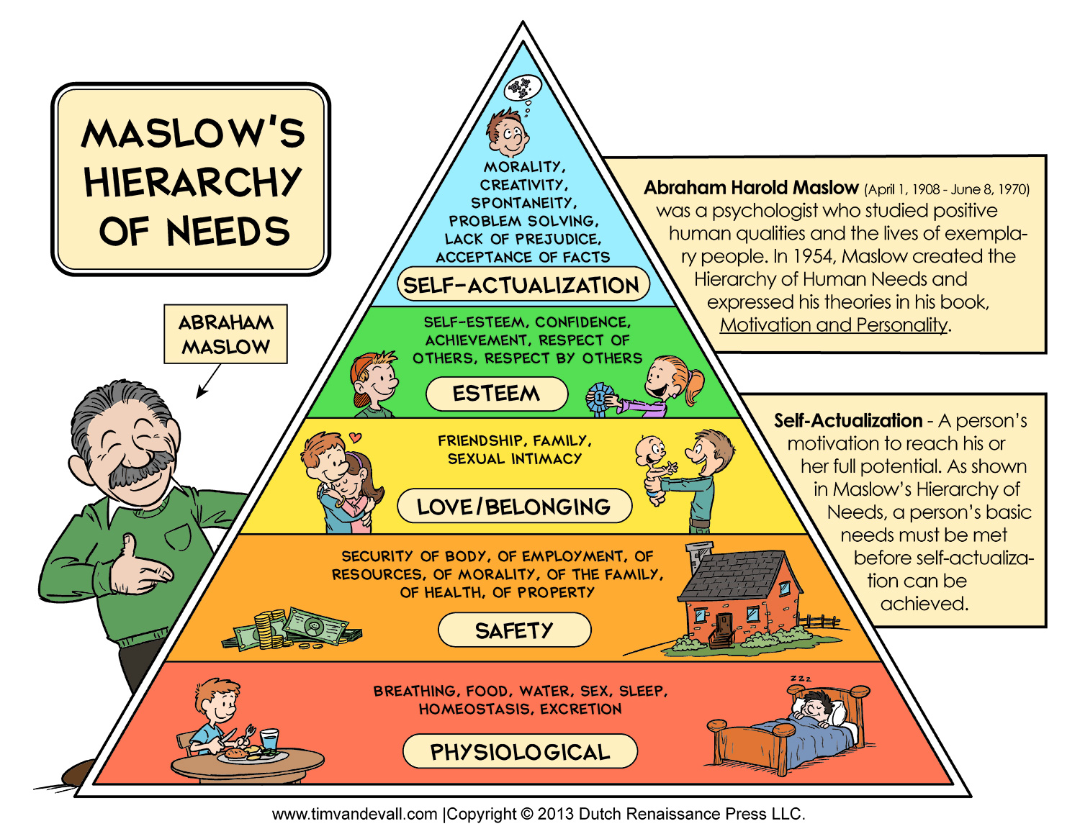

Slide 9
Mental Health Quiz
Please reply saying: “true or false”
Mental illness is more common than diabetes.
Mental illness occurs in 1 out of every 4 families in the U.S.
Mental illnesses are treatable.
Being mentally impaired/challenged is very different from having a mental illness.
It takes medication, years of intense therapy, and counseling to treat a mental illness.
If you answered true to all: you’re a M.I. whiz!

Slide 10
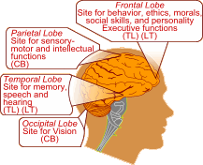
There is a chemical imbalance in the brain of a person with a mental illness.

Slide 11

Optical Illusions
“Same picture, different view”

Slide 12


Slide 13

Which middle line is the longest?

Slide 14
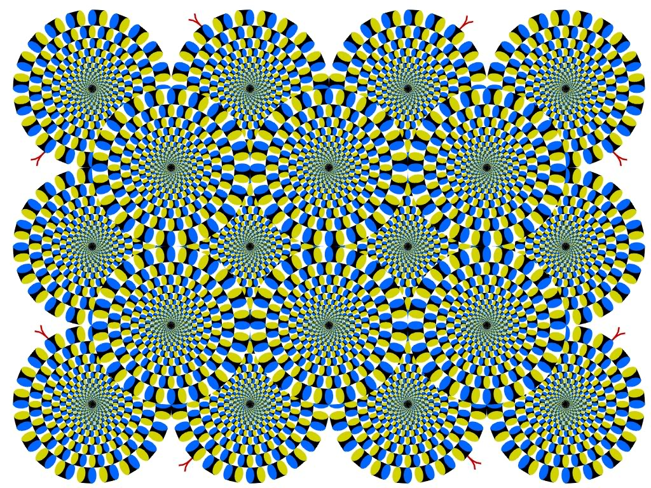
Notes:
Is it moving?

Slide 15
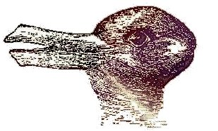
Do you see a duck facing the left or a rabbit facing right?

Slide 16
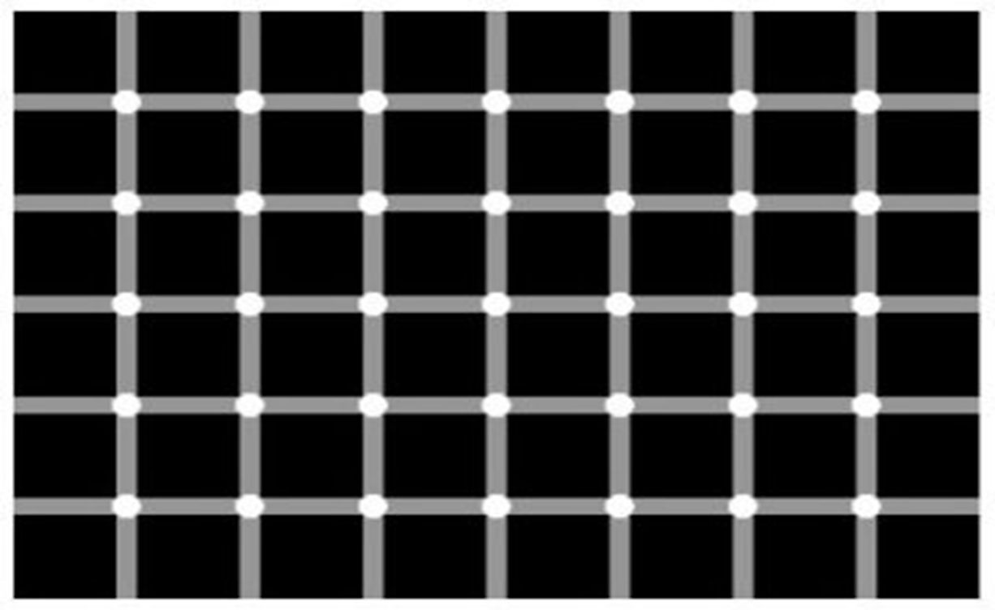
How many gray dots do you see?

Slide 17
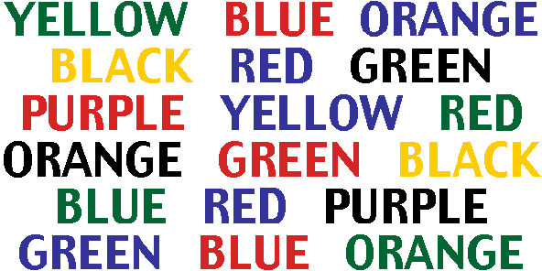
Say the color of each word

Slide 18

Are the horizontal lines straight or diagonal?

Slide 19

Do you see a face or a word?

Slide 20

Stare at the middle dot and the stars eventually disappear!

Slide 21
Relate how you felt if you could not figure out an optical illusion to a person with a mental Illness and/or disorder. http://viscog.beckman.uiuc.edu/flashmovies/15.php

Slide 22

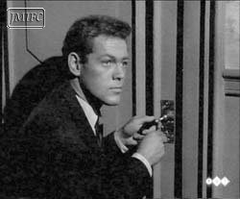
#1: Obsessive/Compulsive Disorder (OCD)
●An uncontrollable need to perform repetitive acts; compulsions are urgent, repeated rituals
●The person may not lead a normal life because compulsions become so repetitive.

Slide 23


Slide 24
#2: Schizophrenia
A condition of losing touch with reality accompanied by reduced ability to function. AKA: Split Mind
-loses ability to distinguish fantasy from reality
-signs of tissue shrinkage in brain
-Some individuals inherit a potential of developing schizophrenia
-Early psychological trauma : Violence, sexual abuse, death, divorce, separation, or other stressors of childhood
Notes:
Emotions may become blunted or very inappropriate. For example, if a person with schizophrenia is told his mother just died, he might smile or giggle or show now emotion at all.
Delusions may include the idea that the person’s thoughts and actions are being controlled, that thoughts are being brodcasted so others can hear them or that thoughts have been inserted into the persons mind or that thoughts have been removed

Slide 25
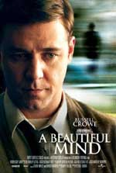

Slide 26
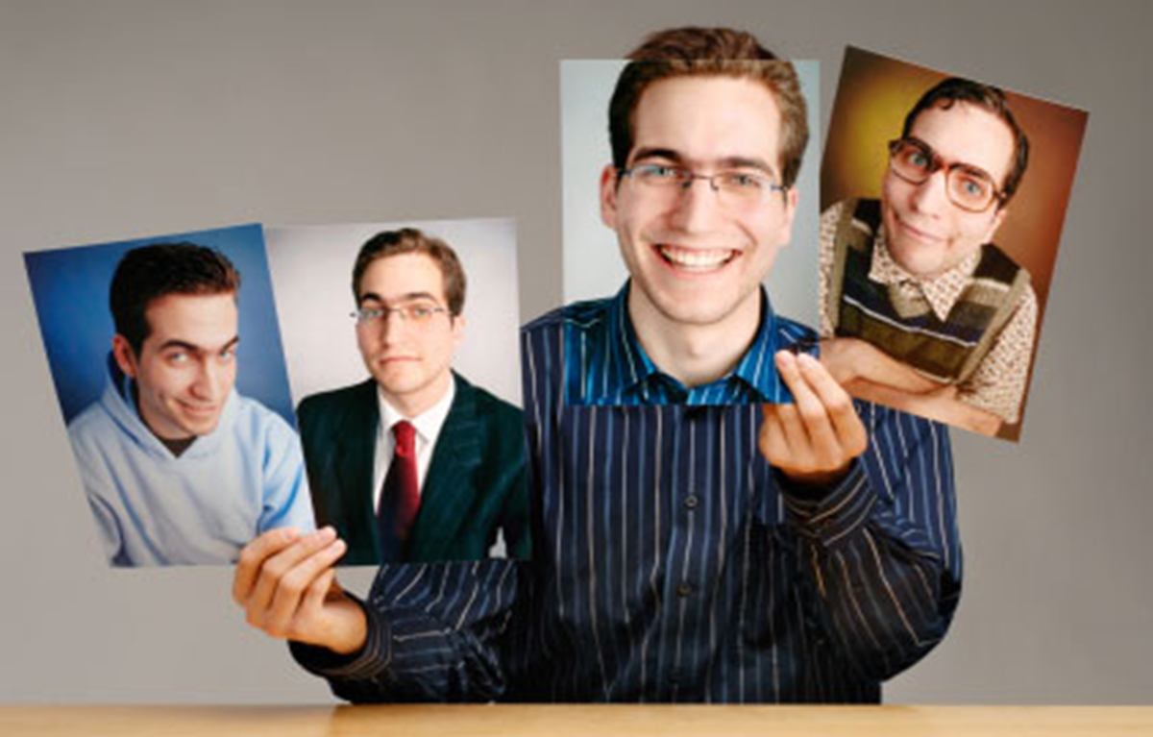
#3: Multiple Personality Disorder
(Dissociative Identity Disorder)
Two or more separate identities or personality traits
  Ability to control individual’s behavior and thinking
  Create alters to distance themselves from pain and trauma
Notes:
Me, myself and irene
Sybil
The three faces of eve
Each with its own relatively enduring pattern of perceiving, relating to and thinking about the environment and self

Slide 27




Slide 28
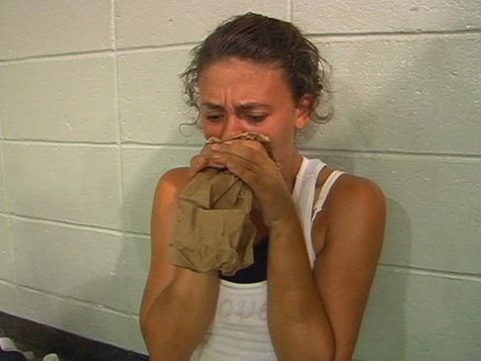
#4: Anxiety
  Someone experiencing anxiety suffers from severe panic attacks and fear in high stress events.
Notes:
Me, myself and irene
Sybil
The three faces of eve
Each with its own relatively enduring pattern of perceiving, relating to and thinking about the environment and self

Slide 29



Slide 30
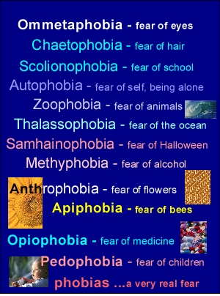
#5: Phobia
  An extreme, irrational fear of an object or situation.
Notes:
Me, myself and irene
Sybil
The three faces of eve
Each with its own relatively enduring pattern of perceiving, relating to and thinking about the environment and self

Slide 31
#6: Attention-Deficit Hyperactivity Disorder (ADHD)
Combination of problems, such as difficulty sustaining attention, hyperactivity and impulsive behavior
Often diagnosed before the age of 7
  As early as 2 or 3 years old
Chronic interference in more than 1 setting
  Home life, school work, sports/activities

Slide 32
Signs & Symptoms
Inattentive
Hyperactive/Impulsive
Fails to pay close attention to details
Make careless mistakes
Trouble keeping attention
Difficulty following through on instructions
Problems organizing tasks or activities
Fidgets or squirms frequently
Often leaves seat
Always seems on the go
Talks excessively or blurts out answers
Difficulty waiting turn
Interrupts conversations

Slide 33

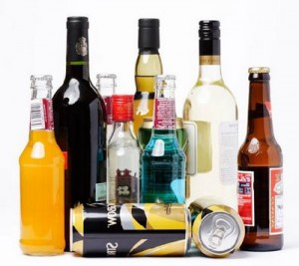

#7: Addiction
A physical or psychological craving need for higher and higher doses of a substance that leads to bodily harm, social maladjustment, or economic hardship; dependence on a substance, habit, or behavior.
, or behavior

Slide 34
Facts & Statistics
From: Methodist Hospital Eating Disorder Institute
90% of women in America are unhappy with their bodies & think they need to lose weight.
75% of men are unhappy with their body & feel they need to trim fat & increase muscle.
Average women in U.S.: 5’4” & 144 lbs.
Average women in media: 5’11” & a whopping 110 lbs.
Between 98-99% of reducing diets fail to produce permanent weight loss.
7 million women and 1 million men and children suffer with an eating disorder. Up to 22% will die!

Slide 35
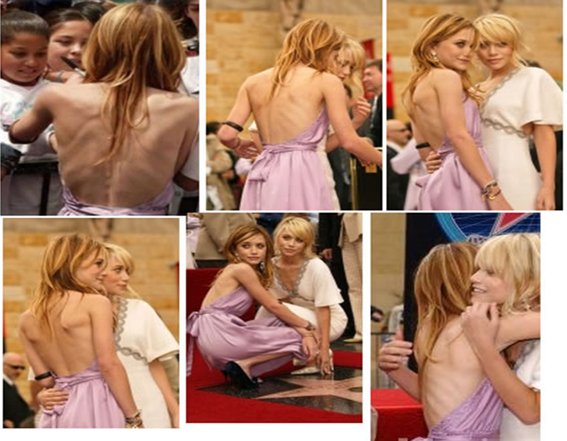
#8: Anorexia Nervosa
A disorder in which the irrational fear of becoming obese results in severe weight loss from self-imposed starvation.

Slide 36
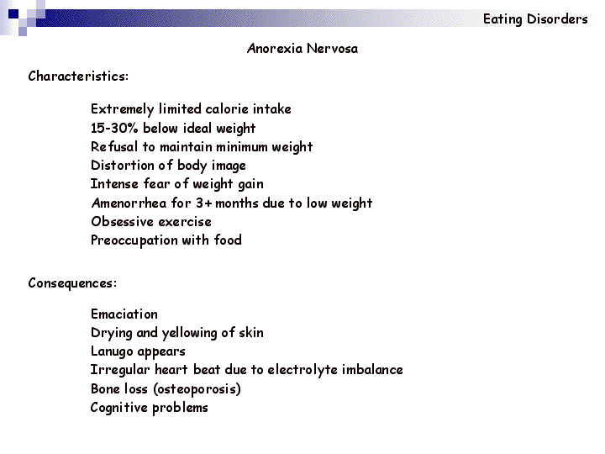

Slide 37
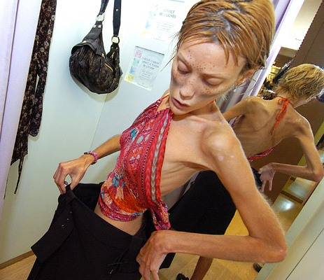
Warning Signs
Dramatic weight loss
Anxiety about gaining weight
Denial of hunger
Food rituals
Excessive exercise
Isolation
Frequent comments about being “fat”
Avoids food situations

Slide 38
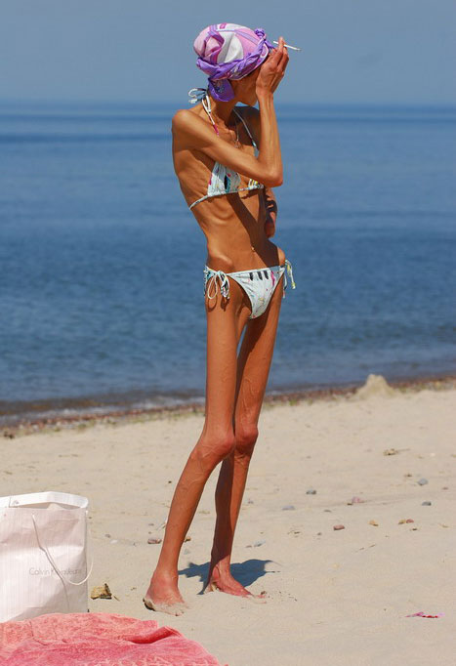
Health Risks
Muscle loss and weakness
  Reduction in bone density
Fainting, fatigue, overall weakness
Dry skin and hair, hair loss
  Growth of lanugo
Slow heart rate/blood pressure
Amenorrhea
Cold intolerance
Heart failure (death)
Notes:
Emotional/Mental:
Depression
Anger
Suicidal thoughts
Low self esteem/body image
Social:
Isolation
Loss of friends
Withdrawal from activities

Slide 39
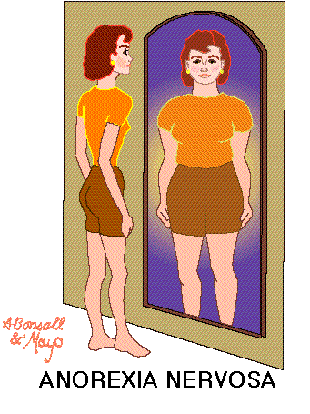

Slide 40
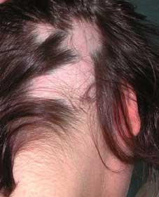
Common Signs:
Alopecia: Hair loss

Slide 41
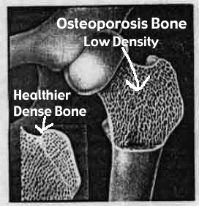
Osteoporosis is common!
(lack of calcium)

Slide 42

Compulsive Exercise

Slide 43
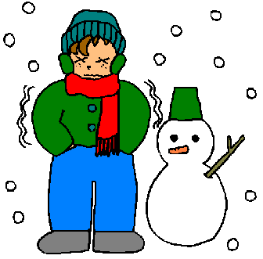
Cold Intolerance

Slide 44
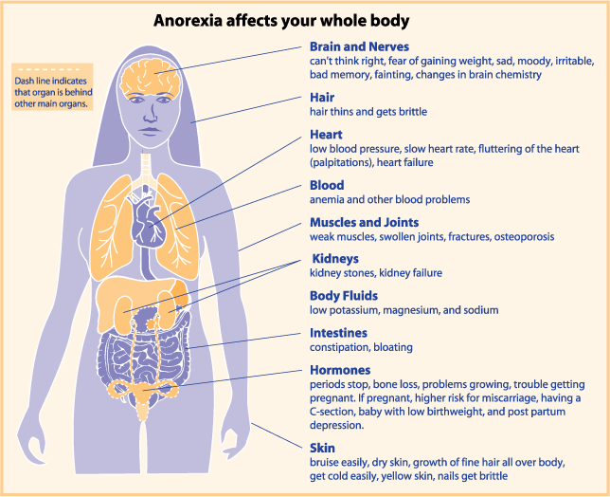

Slide 45
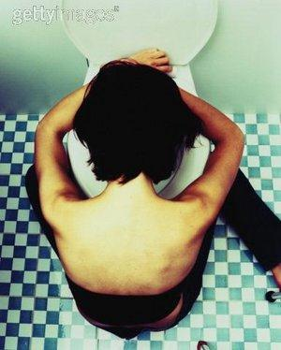


#9: Bulimia Nervosa
Binging and purging, or consuming a large amount of food in a short amount of time followed by an attempt to rid oneself of the food consumed (purging), typically by vomiting, taking a laxative, , diuretic, or stimulant, and/or excessive exercise, because of an extensive concern for body weight.

Slide 46
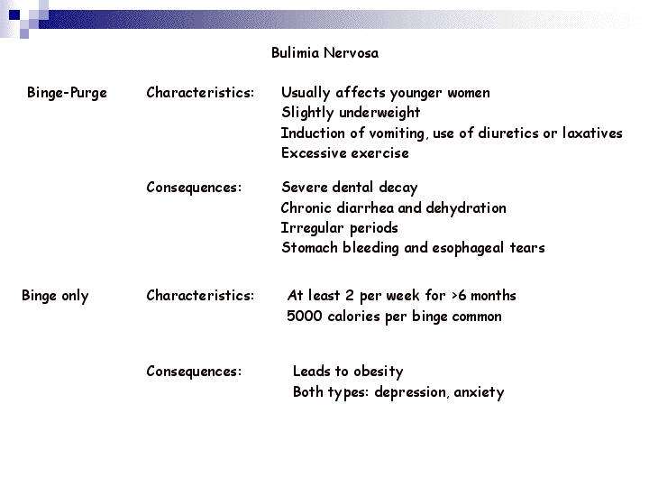

Slide 47
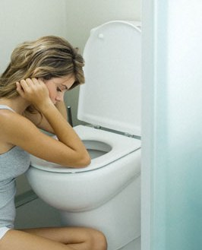
Warning Signs
Buys large amounts of food
Eats secretly, missing food, and skips meals
Weight fluctuation
Excessive use of laxative, diet pills and exercise
Uncontrolled binging
Low impulse to control
Notes:
**low self-esteem, guilt and embarrassment (especially after binge… so they purge)

Slide 48
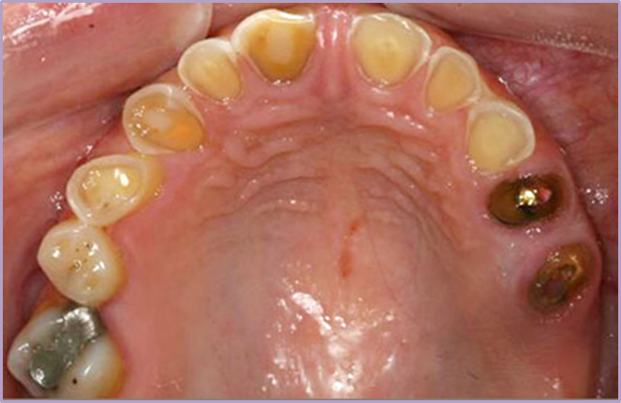
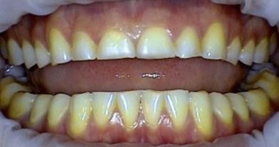
Health Risks
Stomach Rupture
Tooth decay/erosion
Loss of fluids
Risks of seizures
Esophageal inflammation
Irregular bowel movements
Chronic sore throats
Notes:
Most likely to suffer from Eds: dacners, gymnasts, runners, wrestlers, swimmers, jockeys, body builders <<< athletes are vulnerable to eating disorders because their sport has weight constrictions and/or high performance is based on the physique of their body?
**Slightly underweight

Slide 49
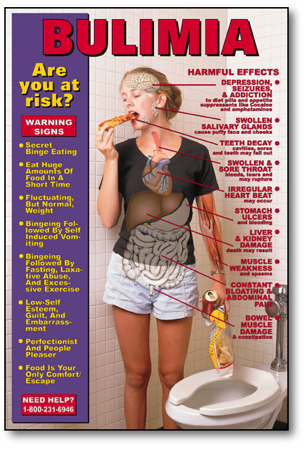

Slide 50
#10: Post Traumatic Stress Disorder
(PTSD) *This is not #’d on your w.sht. Write it off to the side.
Mental health condition that's triggered by a terrifying event — either experiencing it or witnessing it. Symptoms may include flashbacks, nightmares and severe anxiety, as well as uncontrollable thoughts about the event.

Slide 51
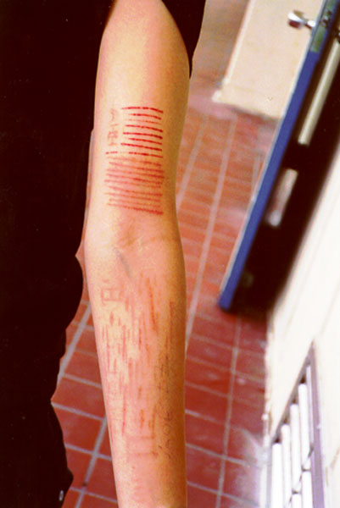
#11: Self-Harm
The act of attempting to alter a mood state by inflicting physical harm that is serious enough to cause tissue damage to one’s body

Slide 52
Common Behaviors
Cutting
Burning
Head-banging
Carving
Scratching
Bruising or hitting
Biting
Picking of skin
Pulling of hair
Bone-breaking

Slide 53
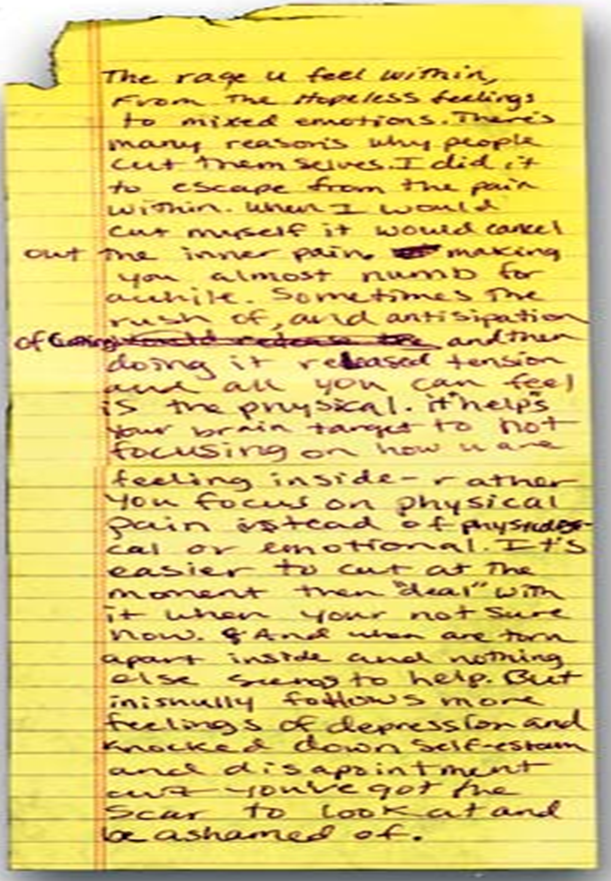
Escape from emptiness and depression
Provides relief
Relieves anger
Escapes numbness
Reality

Slide 54
#12: Depression
Emotional disorders primarily involving sadness, dependency and depression
  Dejection, hopelessness, inability to feel pleasure or to take interest
  Needs medical attention
Notes:
Depression is a serious illness that needs medical attention
Left untreated, depression can lead to suicide
Can be treated and lives when symptoms are recognized

Slide 55
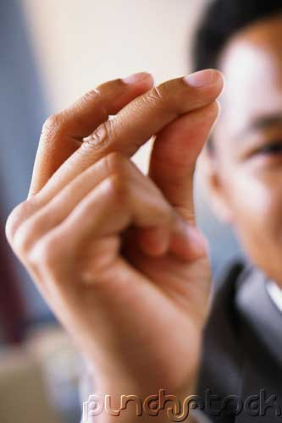
Depression:
“JUST SNAP OUT OF IT!”

Slide 56
Snapping out of depression is as likely as talking yourself out of a heart attack.
Depression is a serious illness that needs medical attention.
If someone is experiencing mild depression for 2 weeks, they should seek help.
Left untreated, depression can lead to suicide.
Fortunately, depression can be treated and lives
saved when symptoms are recognized.

Slide 57
Depression Symptoms
Withdrawal from family and friends
Drop in grades
Change in eating & sleeping patterns
Large weight gain or loss
Unresolved grief over a loss
Substance use
Difficulty concentrating, remembering or making decision irritability or angry outburst
Notes:
If you or someone you know has these symptoms for more than two weweks, ask a doctor for a depression screening

Slide 58

12(a): Seasonal Affective Disorder (SAD)
Depression that only occurs during the fall and winter months
  Oversleeping/difficulty staying awake
  Fatigue
  Social withdrawal
  Inability to cope
Notes:
Almost everyone can get a little depressed when days are short, dark, and cold, but when a person’s systems are lasting and disabling

Slide 59
#12(b): Bipolar Disorder aka: Manic Depression
Depressive Symptoms:
Manic Symptoms:
Loss of energy
Feelings of worthlessness
Difficulty concentrating
Insomnia
Loss of interest
Recurrent thoughts of death or suicide
Severe changes in mood
Increased energy
Decreased need for sleep
Increased talking (too fast or too much)
Disregard of risk
Overly-inflated self-esteem
Notes:
Disregard of risk – excessive involvement in risky behaviors or activities
Grandiose thinking (they think they are more important) example:
**The cause is not known, but it has a genetic component and can run in families.

Slide 60
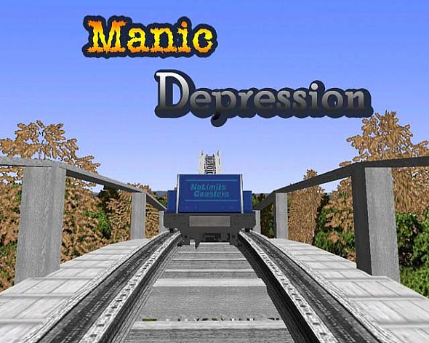

Slide 61
Suicide
#1 cause is: Untreated depression
3rd leading cause of death (15-24 yr. olds)
Most suicidal teens DO NOT WANT TO DIE, rather they feel it is the only way to end their pain.
9 out of 10 adolescents who commit suicide give clues to others before the suicide attempt! (only 10% show no warning signs).

Slide 62
Suicide: Warning Signs
Giving away prized possessions
Feelings of despair, hopelessness
Threats to hurt oneself
Preoccupation with death

Slide 63
Crisis Text Line Support for Teens 24/7
Text "LISTEN' to 741-741
CTL helps individuals in crisis by connecting them with a compassionate, trained listener through a toll-free texting service.

Slide 64



How you can help

Slide 65
You are part of the PROBLEM if you:
Attempt to punish, threaten, bribe, or preach
Cover up or make excuses for their behavior
Take responsibility for the person
Keep the problem to yourself and chose not to tell someone
Notes:
Hide food from a binger or try to force an anorexic to eat
Argue about how much they should or should not eat

Slide 66
You are part of the SOLUTION if you:
Remain calm, unemotional and factually honest in speaking to the person about your concerns
Attend support groups
Encourage your friend to seek help
Do not cover up or avoid the situation and confront the person with your concerns

Slide 67
STEPS to help someone with a mental illness:
1. Share Concern Skill
  I care/love…
  I see…
  I feel…
  Listen – I want/would like, I will…
2. Ask the tough questions
  “Are you depressed? Are you starving yourself?”
3. Tell a trusted adult
Notes:
2) Calmly tell them the specific observations that have aroused your concern.
3) Ask the question: “Are you depressed, starving yourself, hearing voices, etc.?
4) Tell a trusted adult (immediately if the person has problems that scare you!: nurse, teacher, coach, counselor)

Slide 68
Can you recover?
Mental disorders are treatable
Multidisciplinary approach is required:
  Physicians
  Therapists/Counselors
  Dieticians
  Medications

Slide 69
Prevention Strategies
Share your feelings and emotions with someone you trust
Use positive self talk
Manage stress with stress management skills
Use healthy decision making skills
Use effective communication skills
  “I Messages”
KNOW the signs and symptoms

Slide 70
Five Stages of Grief
(Kubler-Ross Model)
This model describes the process by which people deal with grief and tragedy
They apply to any form of catastrophic loss (job, income, divorce, freedom, death, etc.)
These steps do not necessarily come in order, although a person will experience at least two

Slide 71
D.A.B.D.A
Denial
  Initial reaction to a loss
Anger
  Victim can no longer deny feelings.
Bargaining
  May involve praying, alternative treatments, or promising better behavior.
Depression
  Period of grieving for the loss
Acceptance
  Coming to terms with situation

